Slide 1
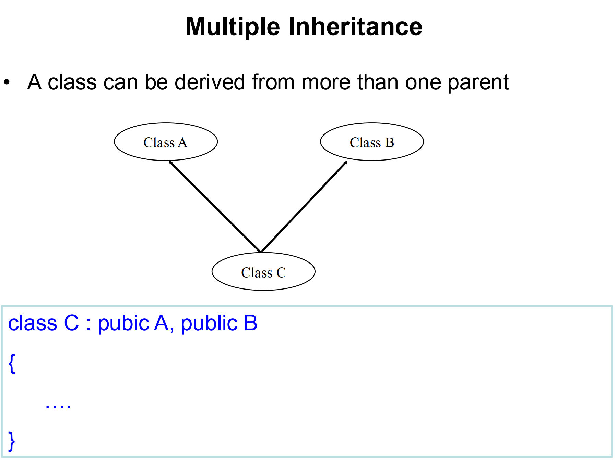

Slide 2
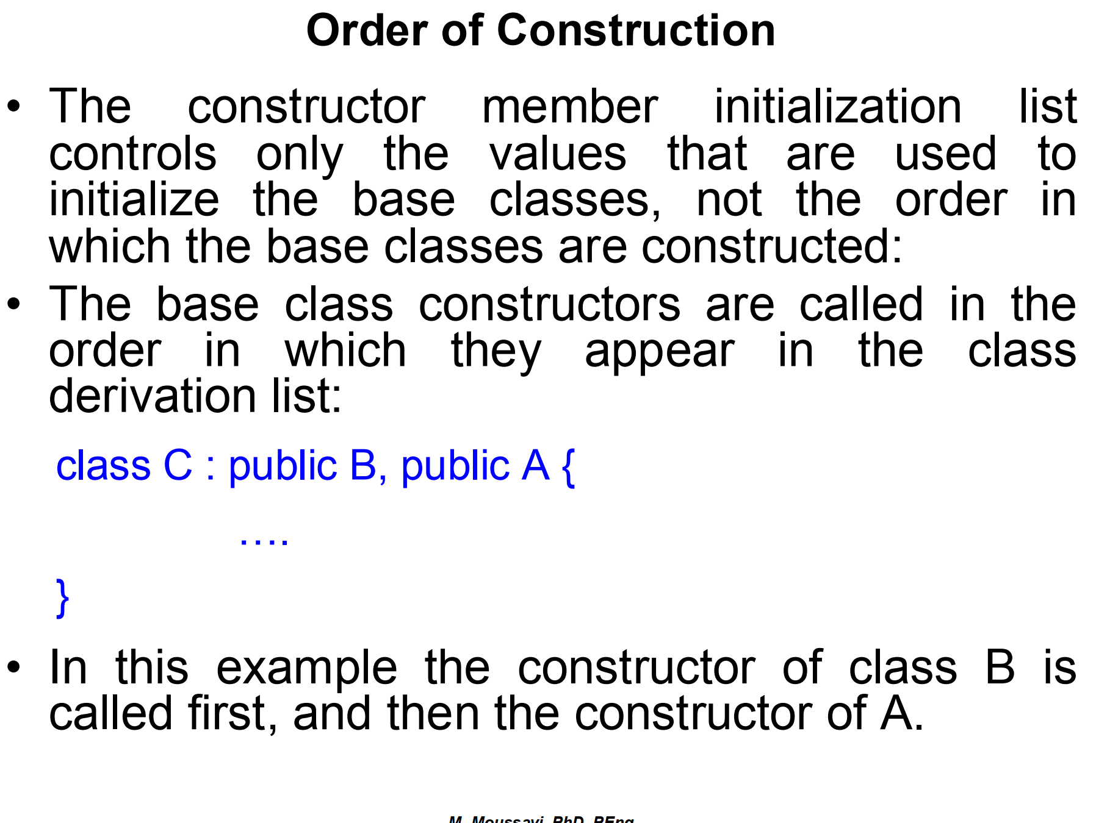

Slide 3
Multiple Inheritance
#include <iostream>
class A {
public:
A() { std::cout << "Constructor of A\n"; }
};
class B {
public:
B() { std::cout << "Constructor of B\n"; }
};
class C : public A, public B {
public:
C() { std::cout << "Constructor of C\n"; }
};

Slide 4
Order of Base Class Constructors
class A {
public:
A() { std::cout << "Constructor of A\n"; }
};
class B {
public:
B() { std::cout << "Constructor of B\n"; }
};
class C : public B, public A { // B is listed first, then A
public:
C() { std::cout << "Constructor of C\n"; }
};
int main() {
C obj; // Output: Constructor of B
return 0;
}
Constructor of B
Constructor of A
Constructor of C

Slide 5
Constructor Initialization List
class A {
public:
A(int x) { std::cout << "Constructor of A with value " << x << "\n"; }
};
class B {
public:
B(int y) { std::cout << "Constructor of B with value " << y << "\n"; }
};
class C : public B, public A {
public:
C() : A(10), B(20) { // Initialization list for A and B
std::cout << "Constructor of C\n";
}
};
int main() {
C obj;
return 0;
}
Constructor of B with value 20
Constructor of A with value 10
Constructor of C

Slide 6
Order of Declaration in the Class Definition
#include <iostream>
class A {
public:
A() { std::cout << "Constructor of A\n"; }
};
class B {
public:
B() { std::cout << "Constructor of B\n"; }
};
class C : public A, public B { // A is declared first, then B
public:
C() : B(), A() { // Initialization list: B first, A second
std::cout << "Constructor of C\n";
}
};
int main() {
C obj;
return 0;
}
Constructor of A
Constructor of B
Constructor of C

Slide 7
#include <iostream>
class A {
public:
A() {
std::cout << "Constructor of A" << std::endl;
}
~A() {
std::cout << "Destructor of A" << std::endl;
}
};
class B {
public:
B() {
std::cout << "Constructor of B" << std::endl;
}
~B() {
std::cout << "Destructor of B" << std::endl;
}
};
class C : public B, public A { // Class C inherits from B first, then A
public:
C() {
std::cout << "Constructor of C" << std::endl;
}
~C() {
std::cout << "Destructor of C" << std::endl;
}
};
int main() {
C obj; // Create an object of class C
return 0;
}
Constructor of A
Constructor of B
Constructor of C
Destructor of C
Destructor of A
Destructor of B

Slide 8
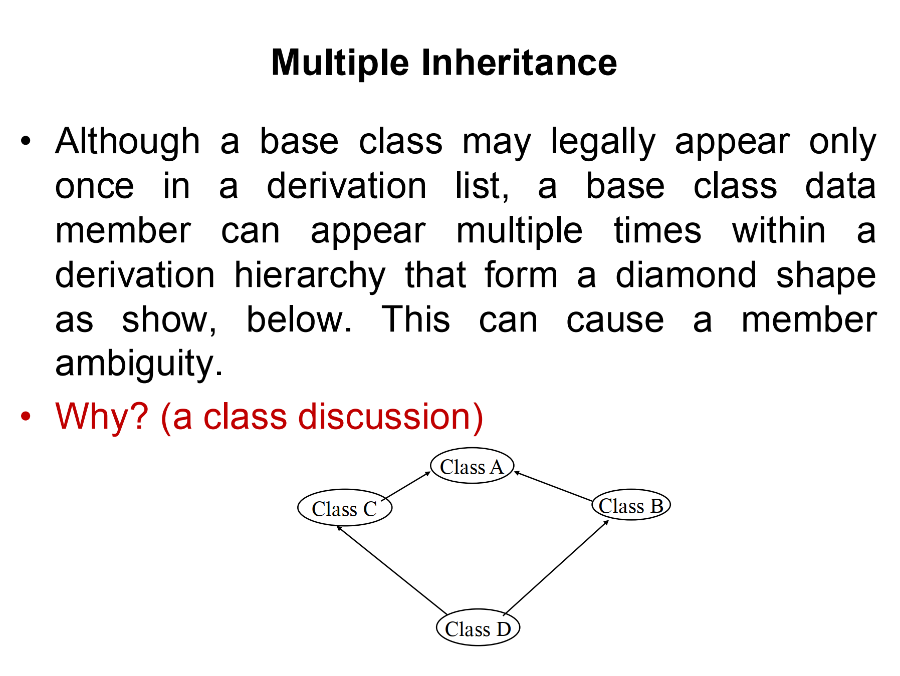

Slide 9
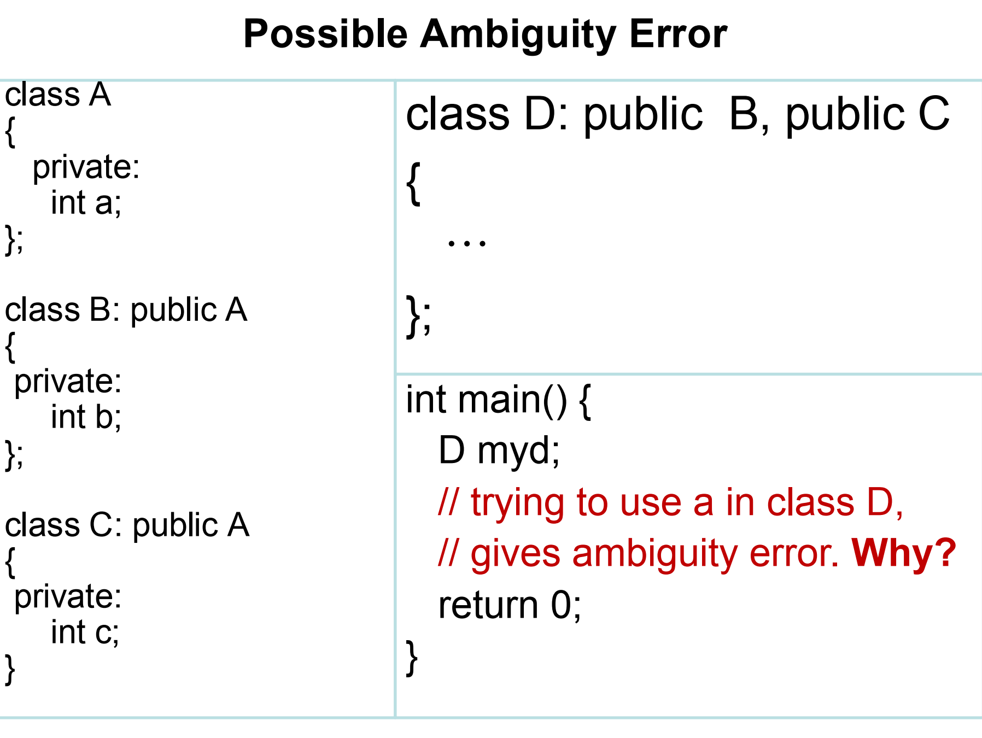
error: request for member ‘a’ is ambiguous

Slide 10
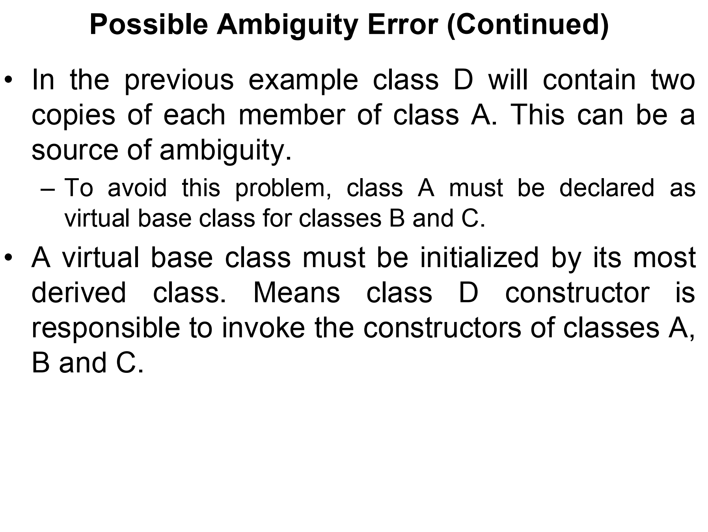

Slide 11
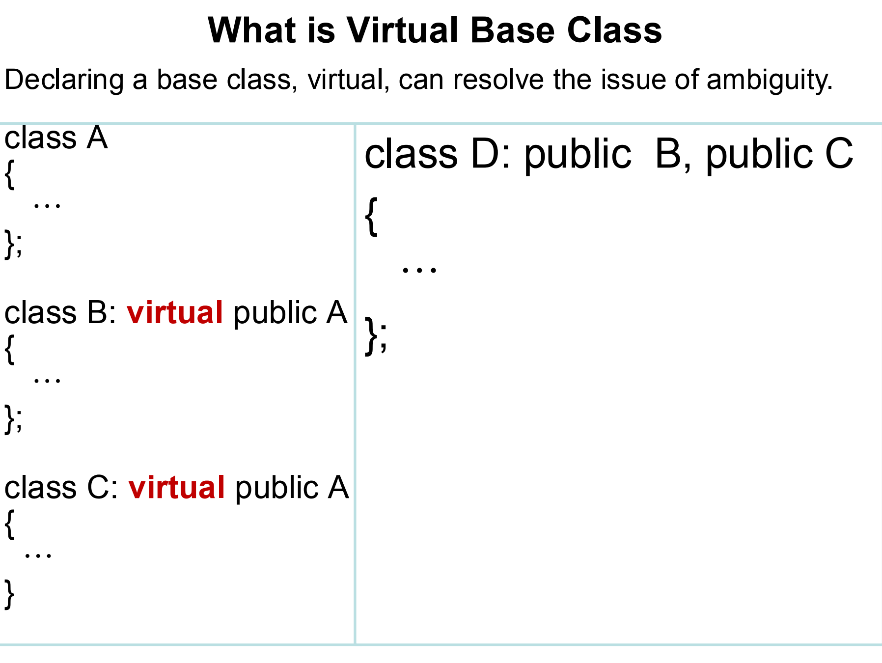

Slide 12
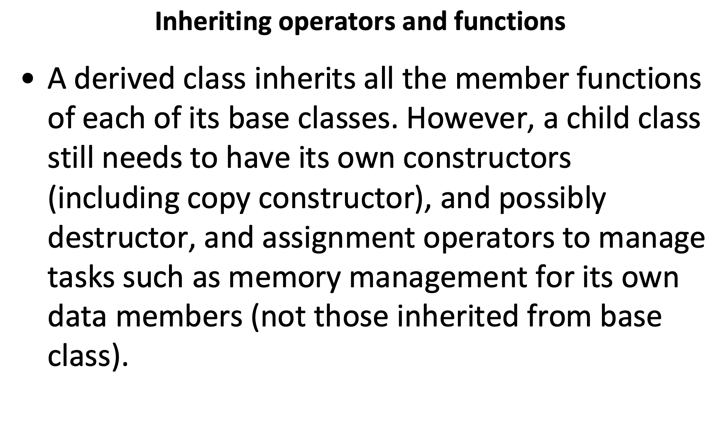

Slide 13
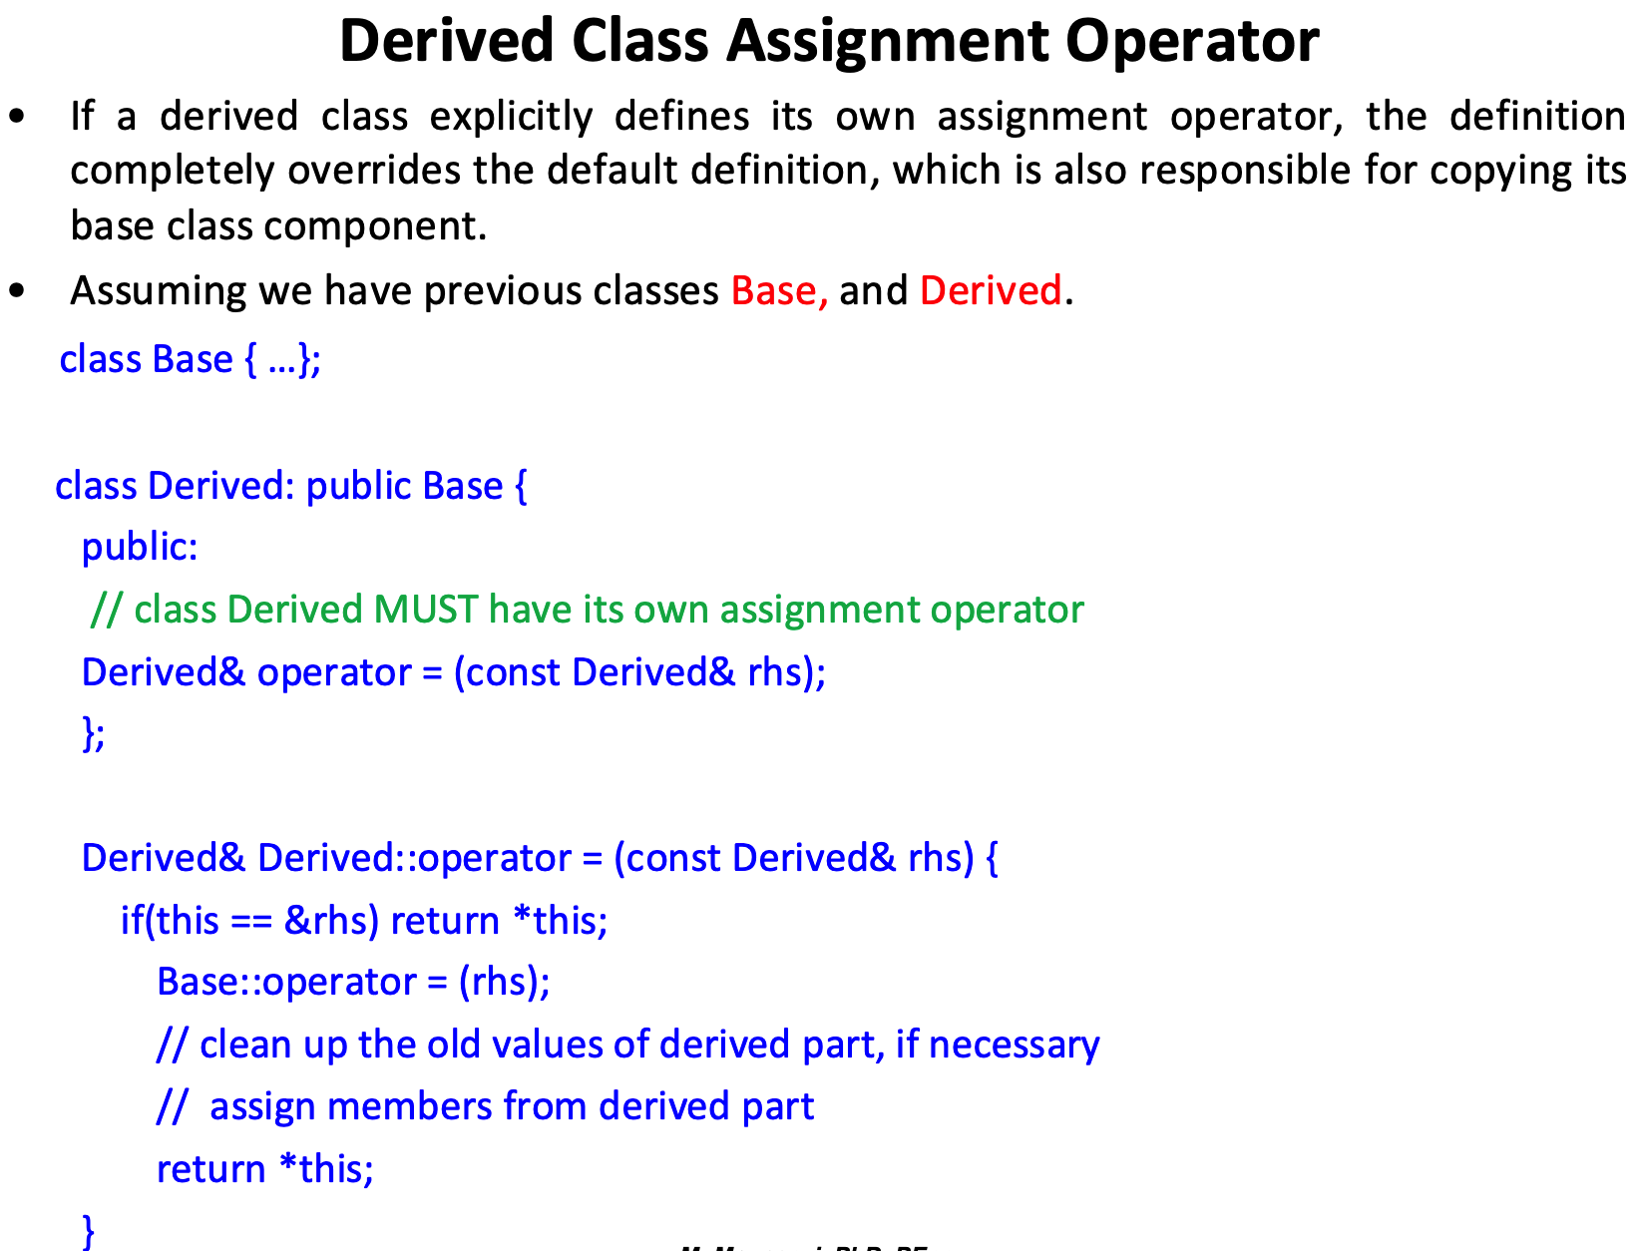

Slide 14
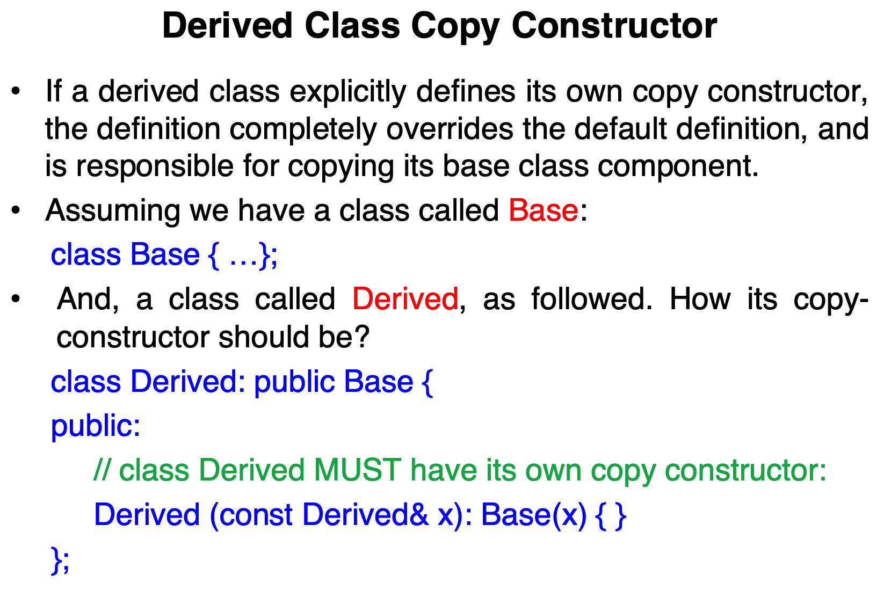

Slide 15
class Base {
public:
int baseValue;
// Base class copy constructor (optional)
Base(const Base& b) {
baseValue = b.baseValue;
}
};
class Derived : public Base {
public:
int derivedValue;
// Derived class copy constructor
Derived(const Derived& x) : Base(x) {
derivedValue = x.derivedValue;
}
};
int main() {
Derived obj1;
obj1.baseValue = 5;
obj1.derivedValue = 10;
// Triggering the copy constructor
Derived obj2 = obj1;
}

Slide 16
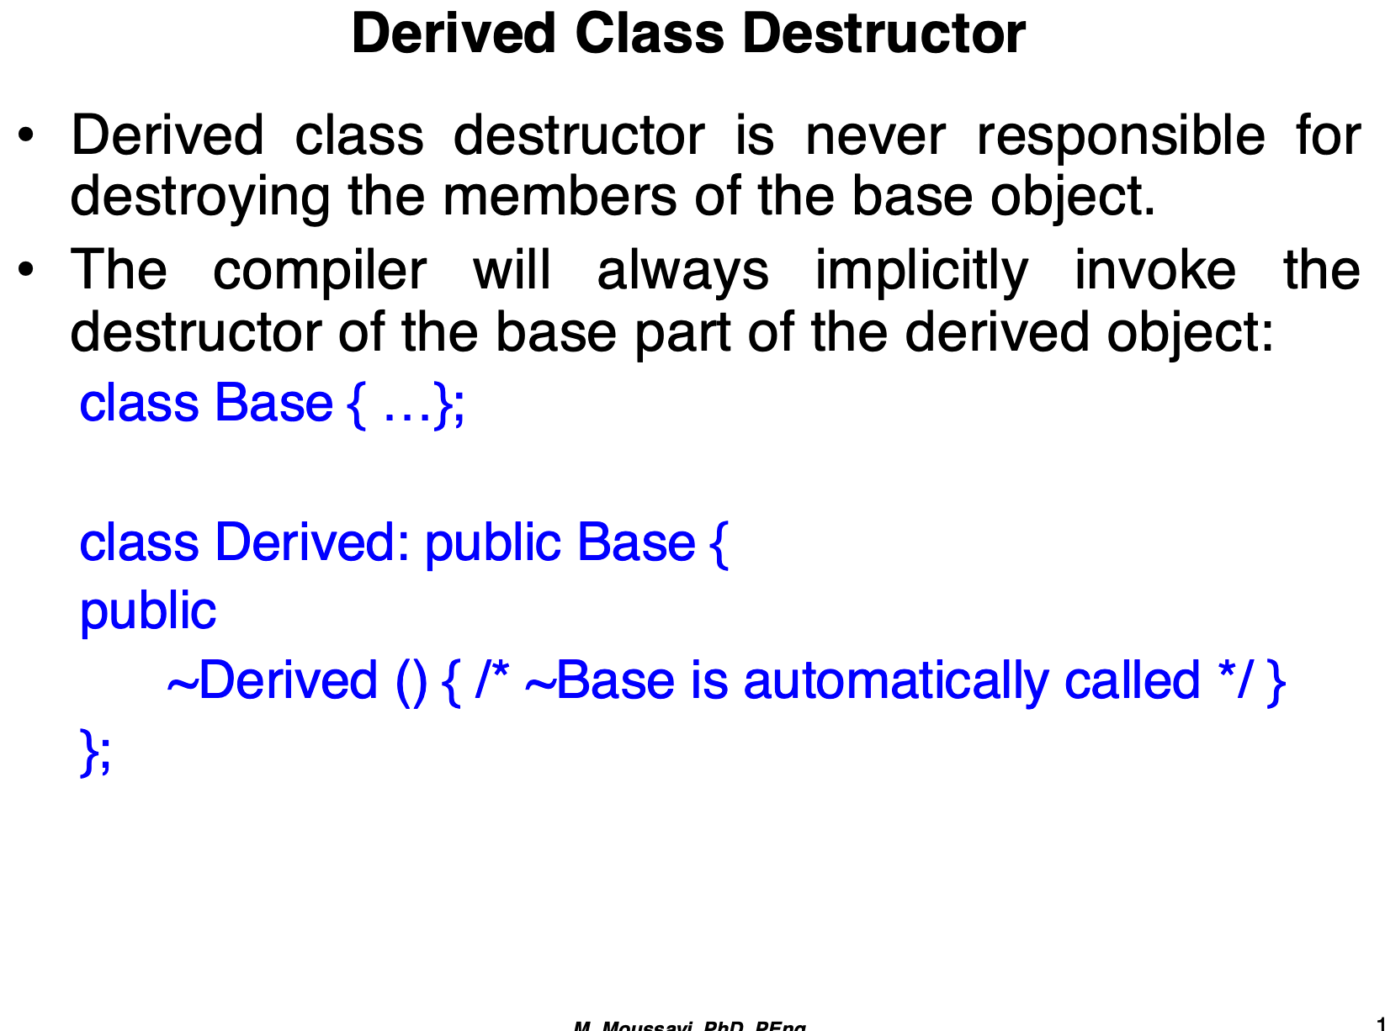

Slide 17
class Base {
public:
Base() { /* Base constructor */ }
~Base() { /* Base destructor, cleans base members */ }
};
class Derived : public Base {
public:
int* data;
Derived() { data = new int[10]; } // Constructor allocating dynamic memory
~Derived() {
delete[] data; // Clean up derived-specific memory
// ~Base is automatically called after this
}
};
Derived obj;

